Slide 1
Topic: Attitudes & Values
Dr. C. Vijaya Banu
Professor , School of Management
SASTRA Deemed University, Thanjavur – 613 401
vijayabanu@mba.sastra.edu

Slide 2
Values
Values
Basic convictions that a specific mode of conduct or end-state of existence is personally or socially preferable to an opposite or converse mode of conduct or end-state of existence.
Value System
A hierarchy based on a ranking of an individual’s values in terms of their intensity.

Slide 3
Sources of values.
Parents.
Friends.
Teachers.
Role models.
External reference groups.

Slide 4
Importance of Values
Provide understanding of the attitudes, motivation, and behaviors of individuals and cultures.
Influence our perception of the world around us.
Represent interpretations of “right” and “wrong.”
Imply that some behaviors or outcomes are preferred over others.

Slide 5
Types of Values –- Rokeach Value Survey
Terminal Values
Desirable end-states of existence; the goals that a person would like to achieve during his or her lifetime.
Instrumental Values
Preferable modes of behavior or means of achieving one’s terminal values.

Slide 6
Types of Values –- Rokeach Value Survey
Terminal Values - Preferred mode of behaviour
Ambitious (hard working , aspiring)
Broad minded (open minded)
Capable (Competent effective)
Cheerful (Light hearted and joyful)
Clean (neat and tidy)
Courageous (standing up for your beliefs)
Forgiving (willing to pardon others)
Helpful
Honest (trustful)
Imaginative (Daring and creative)
Independent (Self reliant and self sufficient)
Intellectual (Intelligent, Reflective)
Logical (Consistent and rational)
Loving (affectionate , tender)
Obedient (Dutiful, respectful)
Polite (Courteous, well mannered)
Responsible (Dependable, reliable)
Self controlled (Restrained, self disciplined)
Instrumental Values – Ultimate end states
A comfortable life
An exciting life
A sense of accomplishment

Slide 7
Types of Values –- Rokeach Value Survey
Instrumental Values – Ultimate end states
A comfortable life
An exciting life
A sense of accomplishment

Slide 8
Hofstede’s Framework for Assessing Cultures
Power Distance
The extent to which a society accepts that power in institutions and organizations is distributed unequally.
Individualism
The degree to which people prefer to act as individuals rather than a member of groups.
Collectivism
A tight social framework in which people expect others in groups of which they are a part to look after them and protect them
Uncertainty Avoidance
The extent to which a society feels threatened by uncertain and ambiguous situations and tries to avoid them.

Slide 9
Hofstede’s Framework (cont’d)
Long-term Orientation
A national culture attribute that emphasizes the future, thrift, and persistence.
Short-term Orientation
A national culture attribute that emphasizes the past and present, respect for tradition, and fulfilling social obligations.

Slide 10
Attitudes
Attitudes
Evaluative statements or judgments concerning objects, people, or events.
Cognitive component
The opinion or belief segment of an attitude.
Affective Component The emotional or feeling segment of an attitude.
Behavioral Component An intention to behave in a certain way toward someone or something.

Slide 11
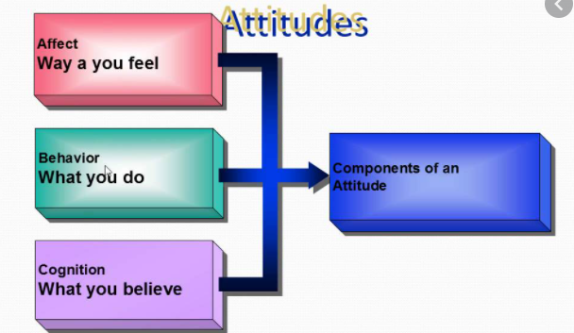
ABC theory

Slide 12
Types of Attitudes
Job Satisfaction A collection of positive and/or negative feelings that an individual holds toward his or her job.
Job Involvement Identifying with the job, actively participating in it, and considering performance important to self-worth.
Organizational Commitment Identifying with a particular organization and its goals, and wishing to maintain membership in the organization.

Slide 13
Attitude -Factors
These are the factors influencing attitude;
Social Factors.
Direct/guidance Instruction.
Family –role & values .
Prejudices.
Personal Experience.
Media.
Educational and Religious Institutions.
Physical Factors.
Economic Status and Occupations

Slide 14
The Theory of Cognitive Dissonance
Cognitive Dissonance
Any incompatibility between two or more attitudes or between behavior and attitudes.

Slide 15
Measuring the A-B Relationship
Recent research indicates that attitudes (A) significantly predict behaviors (B) when moderating variables are taken into account.
Moderating Variables
Importance of the attitude
Specificity of the attitude
Accessibility of the attitude
Social pressures on the individual
Direct experience with the attitude

Slide 16
Self-Perception Theory
Attitudes are used after the fact to make sense out of an action that has already occurred.

Slide 17
Attitude Surveys
Eliciting responses from employees through questionnaires about how they feel about their jobs, work groups, supervisors, and the organization.

Slide 18
Attitudes and Workforce Diversity
Training activities that can reshape employee attitudes concerning diversity:
Participating in diversity training that provides for self-evaluation and group discussions.
Volunteer work in community and social serve centers with individuals of diverse backgrounds.
Exploring print and visual media that recount and portray diversity issues.

Slide 19
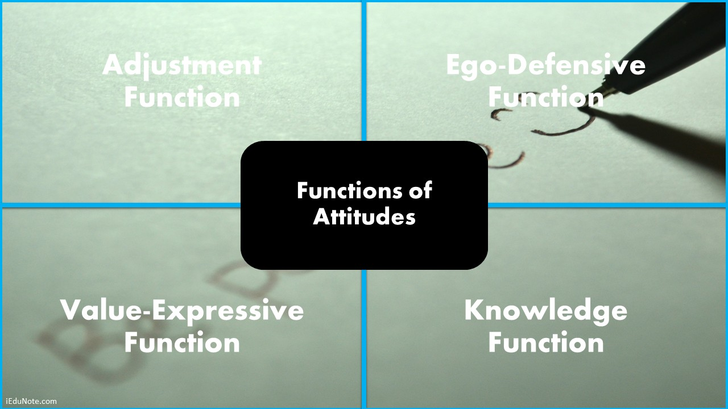
Functions

Slide 20
Thank You

